Slide 1


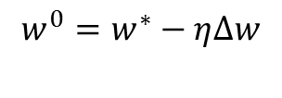

Node 1
SGD
or
Adam
or
AdaGrad
or
Hessian-Free
Node 2
Node 3
……
Node 6
Node 7

